Slide 1
OCD Patient Dataset Demographics & Clinical Data
Tools: Python & MATLAB Domain: Healthcare / Clinical Analytics

Slide 2
Project Objective
Analyze demographic & clinical characteristics of OCD patients
Study OCD severity using Y-BOCS scores
Identify mental health comorbidities
Visualize insights using Python & MATLAB

Slide 3
Dataset Overview
1500 OCD patients
17 variables
Demographics, clinical data, severity scores, medications

Slide 4
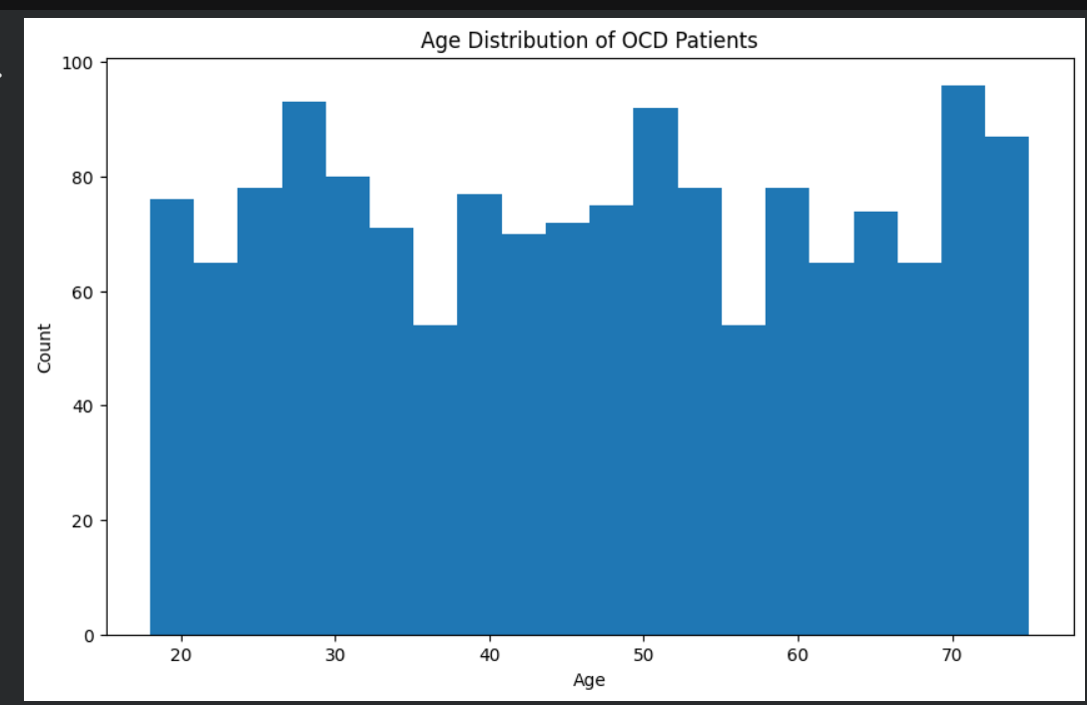
Age Distribution
Histogram of patient age
Insight: Majority of patients are between 30–60 years

Slide 5
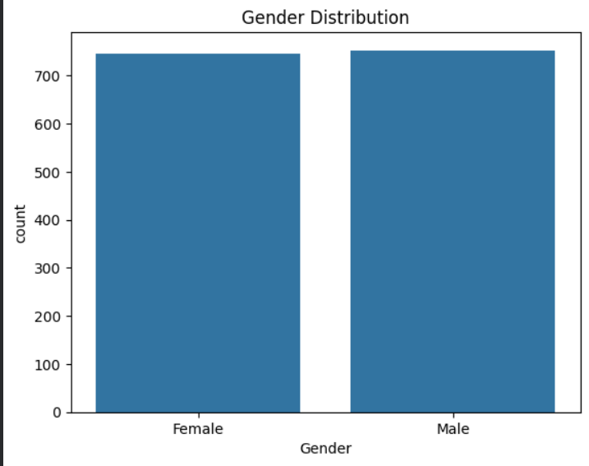
Gender Distribution
Bar chart (Male vs Female)
Insight: OCD affects both genders almost equally

Slide 6
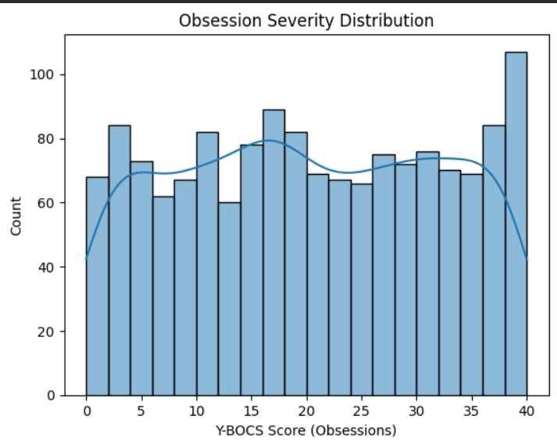
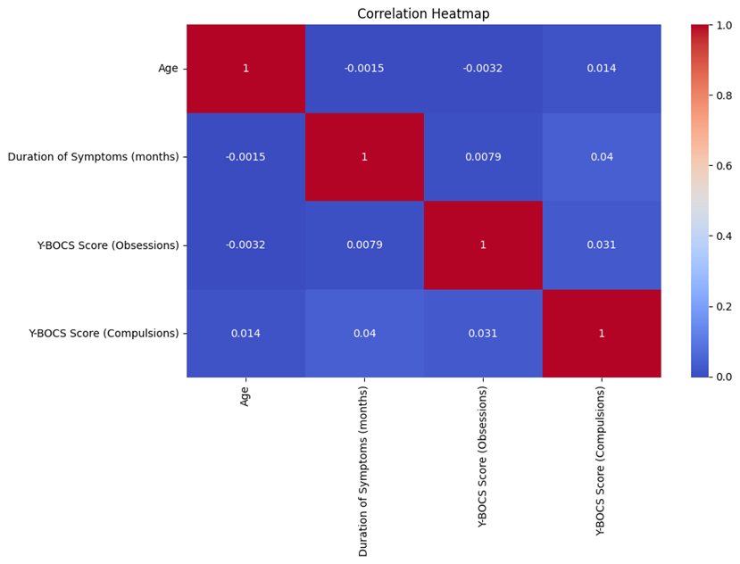
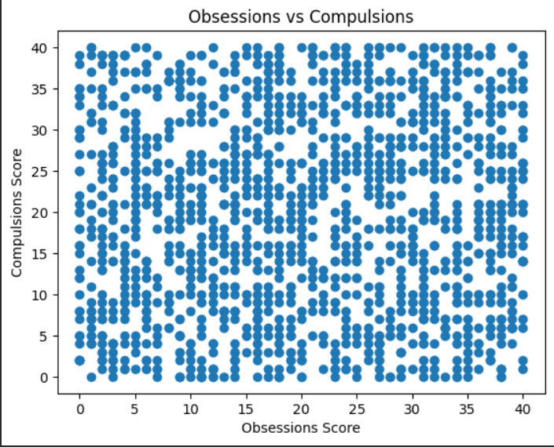
OCD Severity Analysis (Chart)
Scatter plot: Y-BOCS Obsessions vs Compulsions
Insight: Strong positive relationship

Slide 7
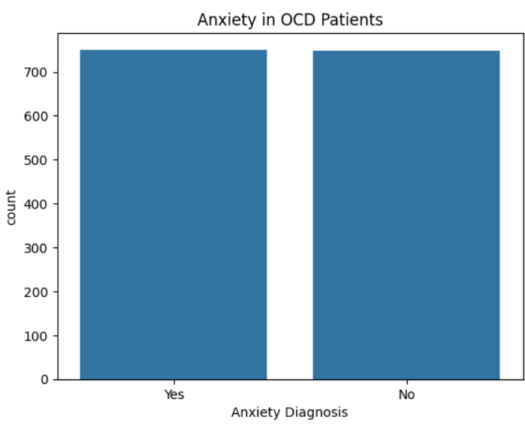
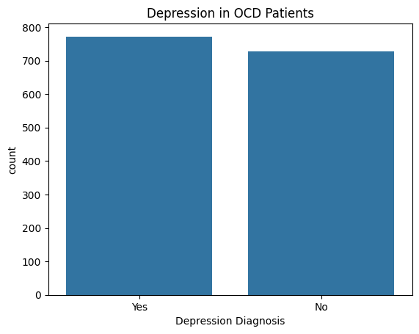
Mental Health Comorbidities
Depression prevalence
Anxiety prevalence
Insight: ~50% comorbidity rate

Slide 8
Key Insights
Long symptom duration (>10 years on average)
Moderate to severe OCD scores
Strong overlap with depression & anxiety

Slide 9
Tools & Methodology
Python: Pandas, Matplotlib, Seaborn
MATLAB: Table analysis & visualization
EDA-based approach

Slide 10
Conclusion
OCD is a chronic condition
Requires long-term clinical attention
Data-driven insights support research & treatment planning

